Slide 1


An Overview of
Community Partnership Schools
“If you want to go fast, go alone. If you want to go far, go together.”
- Proverb

Slide 2

Presentation Outline
The Community Partnership Model
Amy Ellis, UCF Center for Community Schools
The Challenge and Successes
Jarvis Wheeler, Children’s Home Society of Florida
Development and Legislative Commitment
Summer Pfeiffer, Children’s Home Society of Florida
Notes:
AE

Slide 3
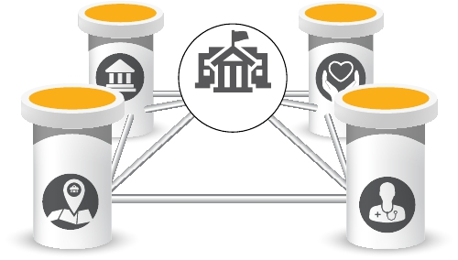
What is a Community School?
A community school
is both a physical place
as well as a set of
partnerships between
a school and other
community resources.
- Coalition for Community Schools
Notes:
AE

Slide 4
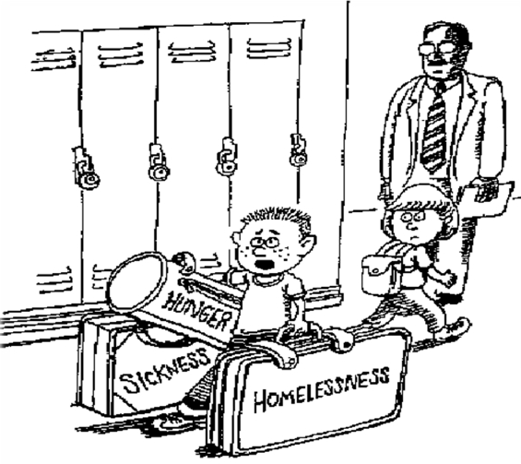
Why Community Schools?
“Could someone help me with these? I’m late for math class.”
Notes:
JW

Slide 5

Community School Mental Models
AKA “Full-Service” or “Extended-Service” Schools
Communities in Schools – A national network of independent 501c3 organizations. Bridge between school and business, faith, and nonprofit entities. Provide a range of services in school setting.
Harlem Children’s Zone – A nonprofit serving poverty stricken children living in Harlem, NY. This federal Promise Zone program is intended to be used as a replicate model in other distressed neighborhoods.
University Assisted Community Schools – Located at the Netter Center at University of Pennsylvania. Employs resources of the university in a number of neighborhood schools located near UPenn. Engages K-16 in real-world community problem-solving opportunities.
Beacon Schools – Utilizes school space to provide a wide variety of activities for students and the larger community. Community organizations partner with school administrators and others to develop programs to meet the community’s needs.
School of the 21st Century – Incorporates child care and family support services into schools. The overall goal is to promote the optimal growth and development of children.
Strive Partnership (Cincinnati) – Supports the success of every child from cradle to career. Approach includes a data-driven model and measures critical developmental milestones in a child’s growth. Partners include schools, nonprofits, local government, business leaders, and local colleges and universities.
Children’s Aid Society (CAS) of New York Community Schools –The Children’s Aid Society of NY joined in partnership with NY Public Schools in 1989 to develop a comprehensive approach to addressing pressing needs of children and families. A community school was developed in Washington Heights as the focal point in the community to which children and parents turn for a wide range of supports and services.
Notes:
AE

Slide 6
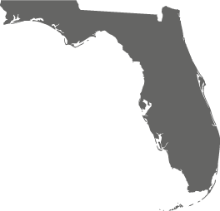



Where are Community Partnership Schools today?
2018-19 School Year
Orlando - Evans High School (Y8)
Brevard - Endeavour Elementary (Y4)
Pensacola - C.A. Weis Elementary (Y4)
Pasco County – Gulfside Elementary (Y4)
Tampa - Mort Elementary (Y3)
Tampa - Sulphur Springs Headstart 6 (Y3)
Jacksonville - Ed White High School (Y3)
Gainesville - Howard Bishop Middle School (Y2)
Sebastian - Pelican Island Elementary (Y2 / School Lead)
St. Augustine - Webster Elementary (Y2)
St. Augustine - Southwoods Elementary (Y2)
Orlando - Academic Center of Excellence (OCPS ACE) (Y2)
Leesburg - Leesburg Elementary – (Y1)
Clay - Wilkinson Junior High (Y1)
Lakeland - Crystal Lake Elementary – (Y1)
Clay - Keystone Heights Junior/Senior High – Planning Period Starts Fall 2018
Tallahassee – Sabal Palm Elementary - Planning Period Starts Fall 2018

Slide 7
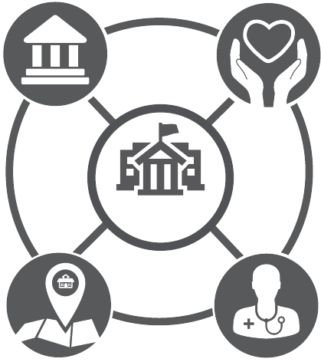
Community Partnership Schools™ Model
What makes Community Partnership Schools Unique?
4 (or more) Core Partners
      Shared governance and development
      Long-Term Commitment
4 Dedicated Staff Members- Focused on 4 Pillars
Organizational Structure
Certification Eligible
Notes:
AE

Slide 8
4 Core Partners
University
or College
Non-Profit
Community
Partnership
School
School
District
Healthcare
Provider
Formal Commitment of 25+ Years
Notes:
JW

Slide 9
Four Dedicated Staff Members
Community Partnership Schools Director
(Collaborative Leadership)
After School Programs Coordinator
(Expanded Learning)
School Health Programs Coordinator
(Student Supports)
Parent and Community Outreach Coordinator
(Family and Community Engagement)
Notes:
AE

Slide 10

The Four Pillars of Community Schools
Collaborative Leadership
A culture of shared governance
and collective decision-making
toward a unified vision to identify
needs and provide resources in
the school and community.
Examples: Shared governance model
among partners, strategic planning and
visioning, community school director
collaborating with partners in operations.
1
Notes:
JW

Slide 11
The Four Pillars of Community Schools
Expanded Learning
Academic support and enrichment
that take place before and after
school, during weekends and
summer, to augment traditional
learning during the school day.
Examples: Tutoring, mentoring, clubs,
enrichment activities.
2
Notes:
JW

Slide 12
The Four Pillars of Community Schools
Student Supports
Access to a range of health and social services that are provided on the school campus.
Examples: Mental health counseling; primary health care, dental health care, health and nutrition education.
3
Notes:
JW

Slide 13
The Four Pillars of Community Schools
Family & Community
Engagement
Bringing families and the community
into the school as partners in
student’s success. Making the
school a neighborhood center
that provides adult enrichment
opportunities.
Examples: Parent resourcing, family and
parenting workshops, classes including
ESOL and GED.
4
Notes:
JW

Slide 14











Community Partnership Schools™
Organizational Structure
Cabinet
Community Leadership Council
Executive Cabinet Committee
Student Leadership Council
Operations Team
Grants Committee
Data Committee
Communications Team
School-Based Teams & Personnel
HUB Staff Team
School Intervention Team
Program and Service Providers
Notes:
AE – Fidelity, Strategic planning, evaluation

Slide 15
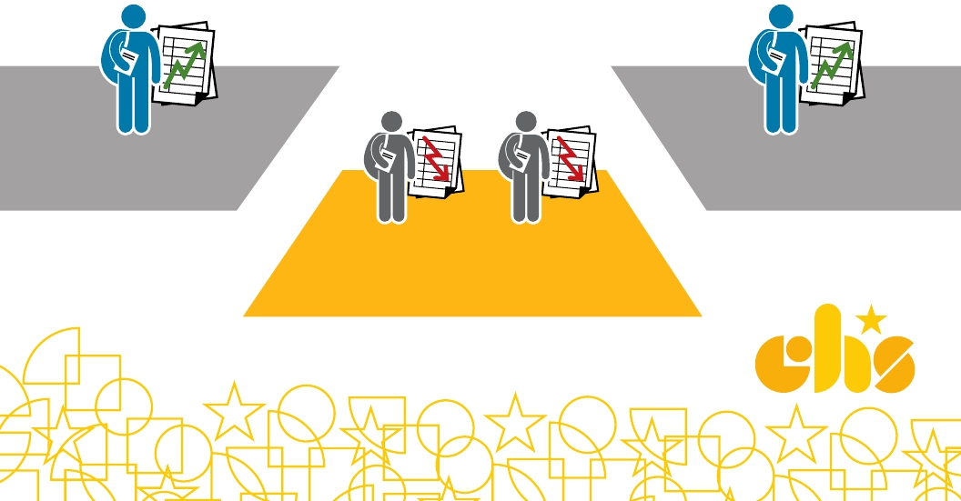
The Challenge
How does a Community Partnership School
bridge the achievement gap?
Barriers such as hunger, poverty,
violence, illness, abuse and neglect can
weigh down under-performing schools

Slide 16


The Solution
The four partners and pillars form a collaborative infrastructure
to eliminate barriers and bridge a foundation for success!
Community
Partnership
School
Notes:
Community Partnership Schools provide the support, services and solutions to help alleviate these burdens … as more weight is lifted, students find the balance to focus on learning so they can realize their full potential.
Community Partnership Schools engage and support parents and the community to empower students and families to succeed.

Slide 17

Positive Results
Increased Attendance
Average daily attendance
95%
92%
Whole school
Students engaged
by CPS hub

Slide 18
Positive Results
Decreased Negative Behaviors
600
567
510
500
471
400
300
200
100
0
371
SY 13-14
SY 14-15
SY 15-16
SY 16-17
Whole School Suspensions

Slide 19
Positive Results
Increased Course Performance
80%
70%
71%
71%
60%
50%
40%
30%
20%
10%
0%
57%
English
Not attending tutoring
57%
Math
Attending tutoring
*Lowest-performing 30% of freshmen class

Slide 20

Safer & Healthier Communities
Calls for Service
one-mile radius of Evans High School (A Community Partnership School)
600
500
400
300
200
100
0
2014
2015
2016
CALLS FOR SERVICE
BATTERY
FIGHT
OFFENSE

Slide 21



Safer & Healthier Communities
Since 2015, calls for fights and battery dropped by 19%*
19%
Economic Impact: $42,480 in savings

Slide 22

Positive Results
Increased Graduation Rates
100%
85%
75%
65%
50%
2010-11
2011-12
2012-13
2013-14
2014-15
2015-16

Slide 23
Positive Impact

Slide 24
Economic Impact
Increased Graduation Rates (Since 2011)
Higher Income Potential:
$1.6M
($4:1 ROI)
Society Costs Avoided:
$43.8M
($109:1 ROI)
http://www.pbs.org/wgbh/frontline/article/by-the-numbers-dropping-out-of-high-school/
Notes:
Research has shown that the income potential increases by more than $10,000 annually for students who graduate. At Evans High School, this means more than $1.6 million in additional income annually.
Additionally, the societal costs are reduced by $292,000 per graduate (over their lifetime). For Evans High School, this translates to $43.8 million in avoided costs to society and taxpayers.

Slide 25
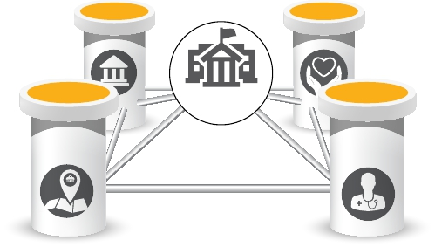
Development
Community Partnership
Schools Operating Costs
$400K
Community
Partnership
School
Notes:
SP

Slide 26

Development
Funding Sources:
Public:
State Legislative Appropriation,
Local Municipal Grants, Medicaid
Private:
Foundations, Corporations,
Individuals, Grants
Partnerships:
Volunteers, Interns, In-kind
Notes:
Approximately 40% of funding has come via non-recurring state legislative appropriation and the other 60% is a combination of grants from private sources and local municipalities.

Slide 27

Development
Social Return on
Investment (SROI)
1:9.9
For every $1 invested, a
community school net present
value of the benefits is $9.90*
http://www.childrensaidsociety.org/files/CAE 20STUDY 20final.pdf
Notes:
SP

Slide 28


Legislative Funding
Historical Commitment - All non recurring funds
FY 18-19 - $1.4million
FY 17-18 - $1million
FY 16-17 - $1.5million
FY 15-16 - $900,000
FY 14-15 - $685,000
FY 13-14 - $400,000
Notes:
SP

Slide 29
Legislative Funding
Funding from Legislature includes:
Center for Community Schools at UCF
  Technical Assistance
  Certification Process
  Allocation to Schools; reporting to DOE
Only 10 of 17 schools; demand has outpaced the appropriation
  Schools receive portion depending on factors of year of implementation and population size
Notes:
SP

Slide 30


Questions?
AMY ELLIS
Director, UCF Center for Community Schools
Amy.Ellis@ucf.edu
407-823-2723
JARVIS WHEELER
Regional Director, Community Partnership Schools
Children’s Home Society of Florida
Jarvis.Wheeler@chsfl.org
SUMMER PFEIFFER
Vice President, Governmental Relations
Children’s Home Society of Florida
Summer.Pfeiffer@chsfl.org
UCF CENTER FOR COMMUNITY SCHOOLS WEBSITE
https://www.cohpa.ucf.edu/communityschools
CHILDREN’S HOME SOCIETY OF FLORIDA WEBSITE
https://www.chsfl.org/services/community-partnership-schools/

